Slide 1

hendi center
Education
Culture
Commerce
Health care
Sport
Tourism

Slide 2






Slide 3

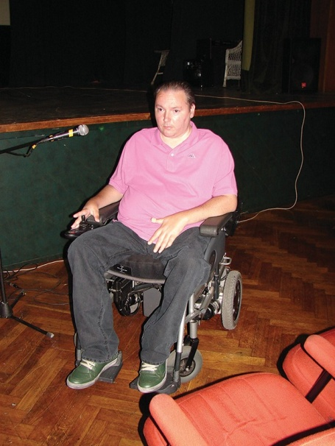
ABOUT US
Hendi Center Colosseum was established in October 2009 and works on achieving goals in the field of management and improvement of the position of persons with disabilities and their integration into all social affairs.

Slide 4


OUR VISION
More righteous society
The Info Center aims to inform local self-governments through their activities and cooperation with local NGO associations about the problems faced by people with disabilities in their everyday life (transport, health, education, sports, recreation, institutions, cultural institutions).

Slide 5
OUR VISION
Full equality
The Info Center aims to inform local self-governments, through its activities and cooperation with local NGOs and associations, on the rights and obligations of society towards them in accordance with the constitution and laws of the Republic of Serbia, as well as international declarations and conventions concerning the rights of the PWD and which Republic Serbia has adopted and signed.

Slide 6
Full equality PWD is guaranteed by the Constitution of the Republic of Serbia, as well as many laws, strategies and action plans
The Constitution of the Republic of Serbia, a provision on the prohibition of discrimination in elderly physical and intellectual disabilities
Law on the Prevention of Discrimination against Persons with Disabilities
Strategy for the Advancement of the Position of Persons with Disabilities In the Republic of Serbia (adopted in accordance with the European Action Plan for Equal Opportunities for Persons with Disabilities, the Council of Europe Guidelines on Establishing a General Framework for Equal Treatment in Employment and Professional Training), Article 13 of the Amsterdam Treaty, Article 15 of the revised European Social Charter and the European Plan of Action for Persons with Disabilities for the period 2006 - 2015 of the Council of Europe
Law on the Confirmation of the Convention on the Rights of Persons with Disabilities
Law on the Confirmation of the Optional Protocol to the Convention on the Rights of Persons with Disabilities
Strategy and promotion of socially responsible business in the Republic of Serbia
Action Plan for implementation of the strategy of development and promotion of socially responsible business in the Republic of Serbia
Draft law on the use of the sign language
Draft law on Social Entrepreneurship and Employment in Social Enterprises

Slide 7
OUR MISSION
Complete integration of people with disabilities into all segments of social life
Full integration into all the spheres of social life involves primarily the provision of access (ramps), reserved space, security, toilets, elevators, adequate workspace, education of employers (informing what PWDs can do in certain circumstances) using tactile treads, braille brackets and audio Equipment, accommodation, transportation, facsimile excursions, personal assistants, equipment, specialized services, professional staff, requisites, priorities, schedules, benefits, subsidies, material and legal assistance ... fulfillment these preconditions is implicit in all segments of social activities such as transport, employment, tourism, education, health, sport, culture, rights and benefits ...

Slide 8
OUR MISSION
Equal treatment in society
Equitable treatment in society is ensured primarily by respecting the Constitution of the Republic of Serbia and by applying laws, decrees, strategies and action plans on discrimination, as well as all signed international declarations and charter dealing with PWD.

Slide 9

OUR MISSION
Realizing all rights in accordance with the positive experiences of developed countries
Implementation of good examples from the lives and practices of countries with long experience and tradition in integrating PWD into all social segments.

Slide 10
The application of anti-discrimination policies implies the adoption of anti-discrimination laws as well as the development of a number of instruments that enable the effective implementation of these laws.
Such instruments must include bodies, forums and activities that allow natural and legal persons who would like to actively pursue an anti-discrimination policy can have the necessary information regarding the possibility of participation of persons with disabilities in the economy, education, culture, sports and tourism.
It is necessary to emphasize the availability and capacity of PWD to participate in social activities as well as to examine needs and plan additional activities to achieve more inclusion of persons with disabilities into the work of local communities and organizational forums, which serve as information services for fostering coordination and linking functions of organizations dealing with anti-discrimination politics in various areas of society.
Such information forums, centers, databases, etc. Can significantly stimulate intersection between various institutions and enable disadvantaged groups to have greater participation in social trends.
In order for such information centers to function, it is necessary to achieve better cooperation between associations of citizens, local self-government, economic entities, state bodies and public institutions (education, health, culture, sports, tourism, social policy)

Slide 11
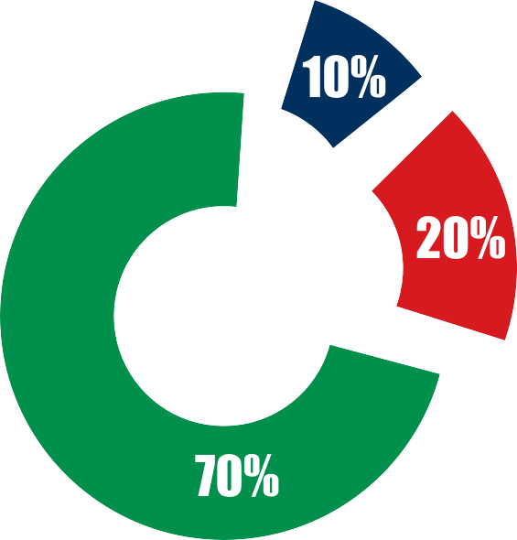
According to research by the World Health Organization, the problems of people with disabilities are solved by 10% on the national, 20% in the regional, and even 70% at the local level. Our basis of the above-mentioned World Health Organization survey, which is shown in the diagram, clearly shows that the greatest responsibility for solving the problems of persons with disabilities belongs to local self-government.
Local level
Regional level
National level

Slide 12
The importance of the Hendi Info Center for PWDs
The Handy Info Center would consist of networked info centers established in municipalities throughout Serbia that would be tasked with continuously gathering information and providing information services to all those who would like to participate in a constructive way in the anti-discrimination policy of employment, education, social and other issues related to PWDs.
This specific database would be for the PWDs and the pre-mapped city map.
PWDs would be able to get information from any area from any city in the country by entering the Handy Info Center site. Also people with disabilities from abroad who are interested in the tour of our country could be informed about everything that is day-to-day PWDs need.

Slide 13
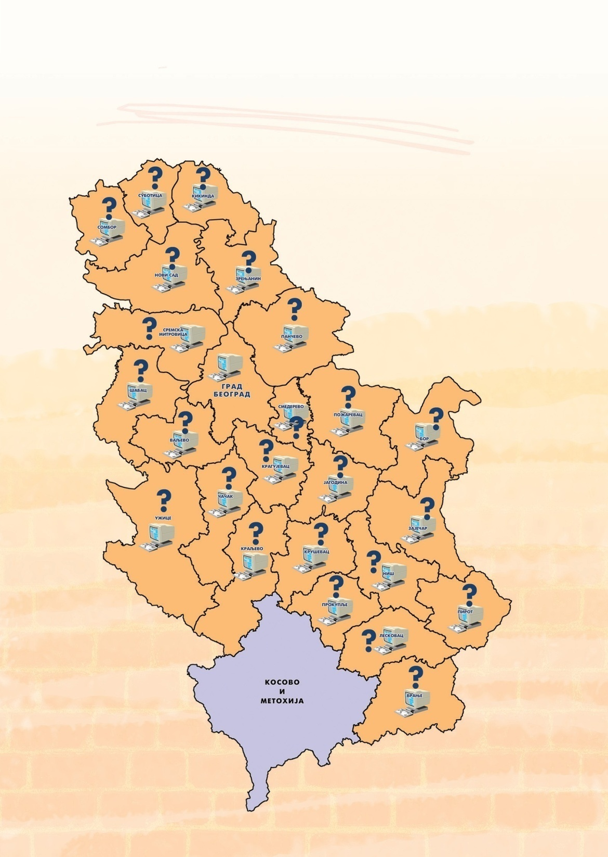
Current situation in Serbia with unconnected PWD centers in major cities
Unregulated input system and non-existent network of computers through which the data would be collected at the local level

Slide 14
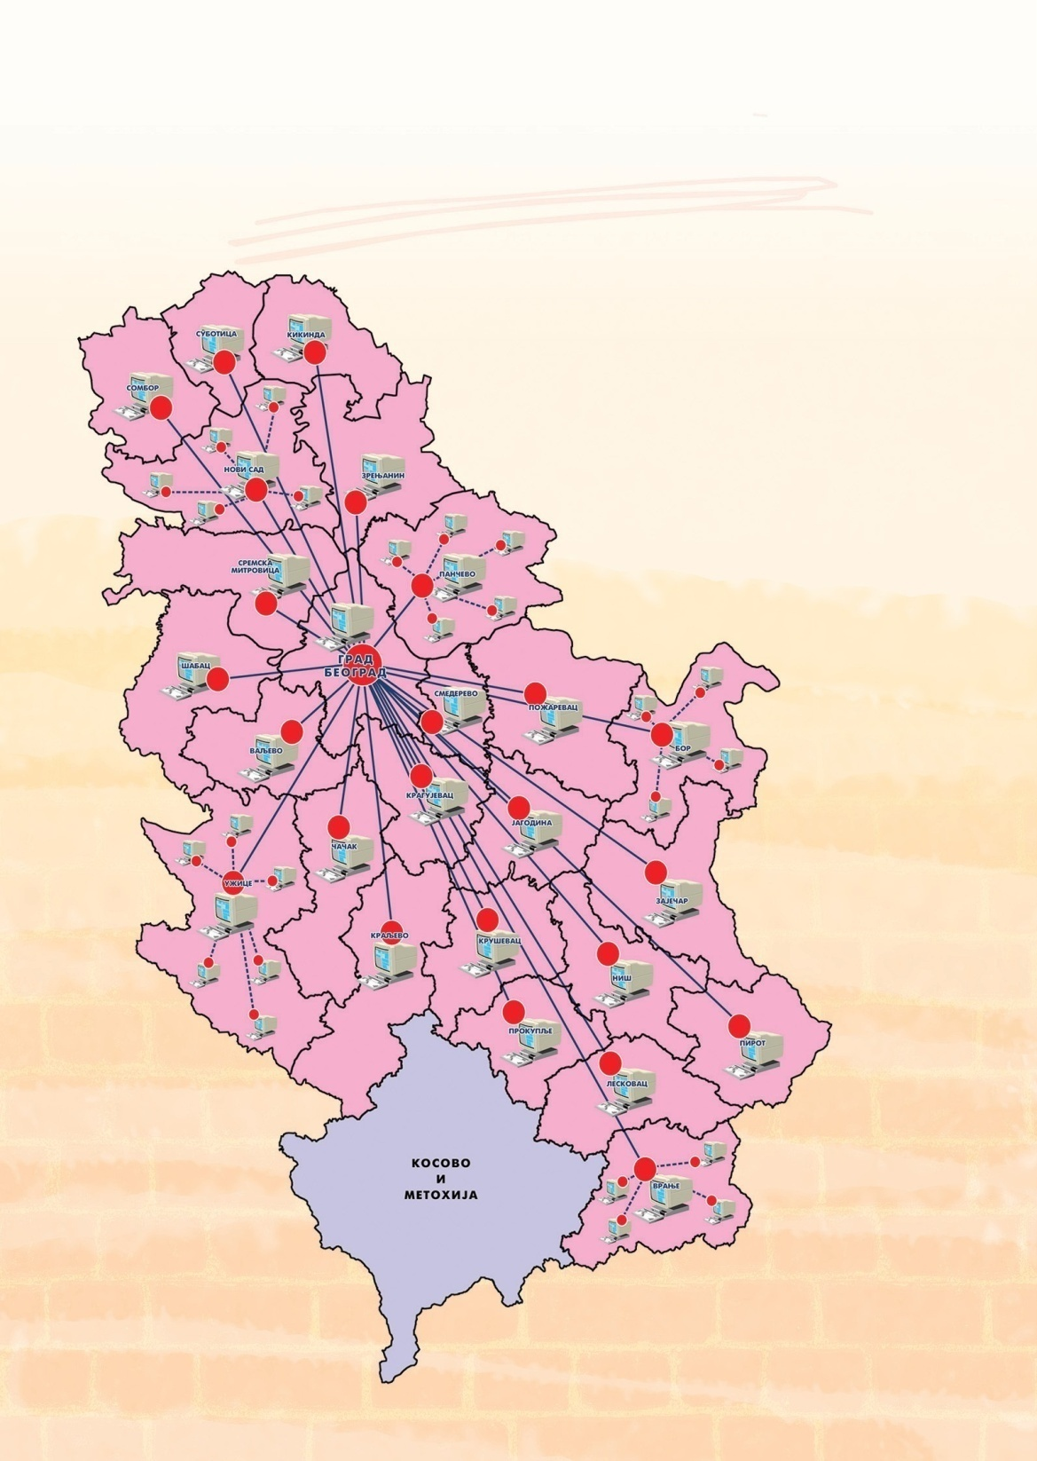
Serbia with connected PVD centers in major cities and WEB application in Belgrade
Establish a network of computers through which data will be entered at the local level

Slide 15
Areas that will be presented through the site
Traffic
- Transport of PWD available, possibility of using pre-disinfected trucks of local public transport, possibility of transport organized by various humanitarian and NGO organizations
Employment
- Creation of lists of people with disabilities, with records on professional and business capacities
Tourism
- Tourist capacities and opportunities for tourism for people with disabilities in terms of organized rehabilitation and other forms of tourism
Rights and benefits
- Legal, social, medical, business and other aspects of defining and explaining the rights and benefits of persons with disabilities
Education
- Educational capacities for children and youth with disabilities, as well as the possibility of qualification, retraining, additional qualifications and other forms of career guidance for persons with disabilities

Slide 16
Areas that will be presented through the site
Sport
- Keeping records and coordinating activities related to sports, recreation and rehabilitation activities for persons with disabilities
Volunteerism
- Organization and coordination of volunteers who would like to help people with disabilities in everyday and other activities
Health care
- Medical and other aspects of coordination and activities related to therapy and rehabilitation of persons with disabilities
Catering
- Access to restaurants, taverns, coffee shops

Slide 17
This model of the Handy Info Center consists of a database of various records
1. Records of persons with disabilities
2. Records of institutions and state agencies related to social policy
3. Records of non-governmental organizations dealing with social
policy issues, volunteerism and work with persons with disabilities
4. Records of available catering and tourist facilities in Serbia
5. Records of health institutions working with people with disabilities
6. Records of educational institutions for adults, children and young people
7. Records of initiatives, tenders and projects announced by local governments or state bodies
8. Records of Donors and Other Humanitarian Organizations Supporting Projects Based on Anti-Discrimination Policy
9. Records of international organizations dealing with social policy issues related to persons with disabilities
10. Records of sports and other recreational activities, organizations and institutions for persons with disabilities

Slide 18
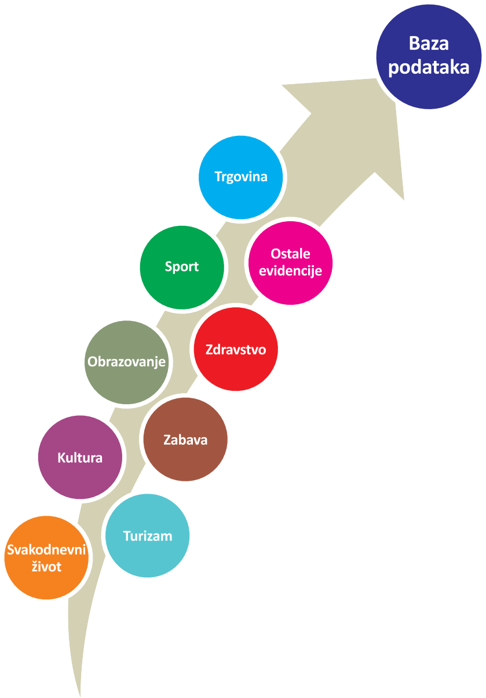
Database and WEB applications

Slide 19
Everyday life
- public institutions
-the post office
-banks
-exchange office
Culture
- Theaters
- concert halls
- a theater
Education
-School
-Faculties
-Libraries
-Kindergartens
-Youth hostels
-Student homes
Health care
-Homes of health
-Hospital
-Pharmacies
-Clinics
-Private clinics
-Dental clinics
Sport
-Stadiums
-Outdoor terrains
-Halls
-Sports centers
-Balloons
-Fitness centers
Trade
-Markets
-Shops
-shopping centers

Slide 20
Tourism (facilities)
-Cafes
-Pubs
-Pizzeria
-Pubs
-Pastry shop
-Restaurants
-Rafts
Tourism (travel)
-Agencies
-Embassies
-Spa
-Excursionists
Tourism (accommodation)
-Hostels
-Hotels
-Motels
-Camps
Fun
-Discotheques
-Clubs
-Rafts
Tourism (landmarks)
-Churches
-Monasteries
-Galleries
-Museums
-Parks
-Squares
-other
Other records
- Persons with disabilities
- International - humanitarian and social organizations
- NGOs dealing with issues of social and humanitarian policy
- Donor organizations
- State institutions and social policy agencies
- Other

Slide 21
Within the Hendi Info Center it is planned to install a portal which will have the function of public presentation of the info center
1. Site
News site and information about the work of the info center. The site will be made according to accessibility criteria for people with disabilities in order to be able to use the website at full capacity
2. Forum
Forum discussing individual issues of information centers, asking questions from practice, exchanging ideas, information, initiatives. The forum will be public and it will also be open to anyone interested in this activity, regardless of whether they are volunteers, employees in local self-governments, people with disabilities, members of associations of citizens, members of families of people with disabilities
3. Mailing list
Local self-governments should help establish an information center in municipalities in Serbia. Each municipality should, through its bodies, take an active part in the creation of info centers that will collect and provide information from various PWD related areas.

Slide 22

CONCLUSION
Logical conclusion is the necessity of linking associations of people with disabilities at the level of the whole republic as well as adequate entry, exchange and central updating of data.
This would certainly give people with disabilities different benefits in the form of planning, communication, guidance, employment, assistance, etc. We hope that this brochure will help you to see the necessity of the first of all the importance that PWD would have for this imaginary database and web applications.

Slide 23




PROJECT
Training for initiation and development of services and services of personal assistants and info centers in the cities of Serbia
We are grateful for the support of the Ministry of Labor, Employment and Social Policy of the Republic of Serbia

Slide 24




