Slide 1




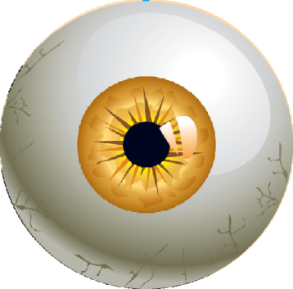







hendi centar
KOLOSEUM - BEOGRAD
Film workshop
Don’t call me special
Sponsors:
Skupština grada Beograda i NIS Gazprom neft
Beograd

Slide 2








Film
2
Art
Media
Means of communication and education with wider population of typical viewers
Film context of persons with disabilities

Slide 3




3
This powerful medium of these distorted images infiltrated the public and added stigma to the already misunderstood disturbances (Kondo, 2008, p. 250)

Slide 4

History
4
For the first time in the history, disability is mentioned in the 50 seconds video in 1898.
After 1912. - Disability is mentioned as something that can be cured through medicin
1930s- recorded the most horror movies (Dr. Jekyll and Mr. Hyde I Frankenstein)
After the Second World War the topics that prevailed were related to war veterans

Slide 5







5
Hollywood for the first time realistically shows people with disabilities in 1946 in The Best Years of Our Lives
Seventies were marked by two movies: The Other Side of the Mountain (1975) and Apocalipse Now (1979)
Eighties and nineties years were marked by movies which showed persons with disabilities like criminals or like persons who had the intention to incite people in the public to regret them.
Today films are not shown in one dimension, but in movies there are different characters so we can find positive and negative examples of showing persons with disability

Slide 6

6
Difficulties
Autism
Visual
imparement
Intelectual
Physical disability
Hearing
damage
difficulties
The boy who could fly
Quest for Camelot
Charly
When the Whales Came
Intouchables
Tim
My left foot
Sneakers
House of cards
Being there
The Miracle Avatar Worker
Born on Mr. Holland's 4th July Opus
Whose life is
Immortal it anyway Beloved
The miracle worker
Forrest Gump
FILMS
Mercury rising
Scent of a woman
Heart of the dragon
Little voice
Wait until dark
The wizard
Of mice and men
Children of a Lesser God
Rain man
What's eating Gilbert grape

Slide 7


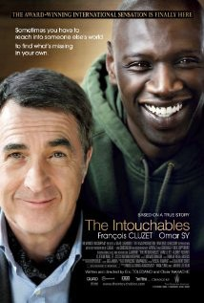

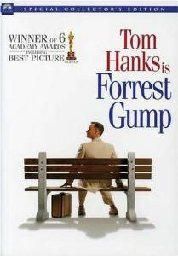

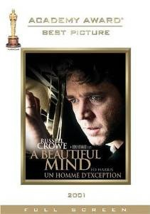
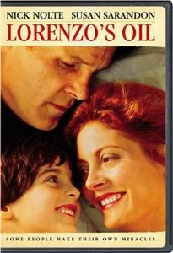
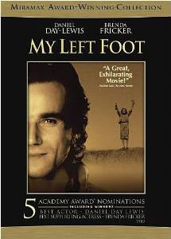
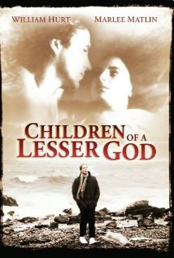
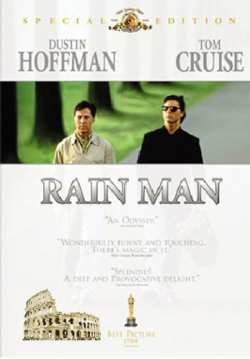
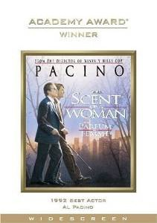
7

Slide 8






8
Feature movie with persons with disabilities as a part of research
Film industry shows people with disability in erroneous and distorted way and discriminate them. That leads to stereotypes and in the film industry there are 7 types of stereotypes which are the most frequent. (Nelson, 1994. to Black and Pretese , 2007).
-The first stereotype shows persons with disability as infantile and incapable, or as persons who depend on the help of others
-The second stereotype shows persons with disability like brave persons who can cope with their difficulties
-The third stereotype is marked by words like evil, sinister and punishment, and it means that persons with disability are less valuable than typical people.
-The forth stereotype interprets the life of people with disabilities as a life not worth living and suggests that suicide is a way of solving his or her problems
-The fifth stereotype shows that disability is primarily a problem of emotional coping and self-acceptance, and with the right attitude, anyone can cope with disability.
-The sixth stereotype draws attention to people with disabilities to those who care about them and displays them as a good and merciful people because their power and time devote and consume on a person with disabilities.
-The seventh stereotype shows a disabled person as a person who can not live a successful life, to develop a personal role, to have the profession and free time, just because of disability.

Slide 9
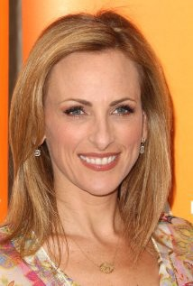
9
Actors with disability
-directing the movie industry to show the diversity and includes actors with disabilities in the stories that appear on the big and small screens
-there is a fear of advertisers and networks that person with disability will require more finances and time
-associations of persons with disabilities - They believe that people with disabilities can act out that role even better and that is not about ideology, but they should be given the opportunity to demonstrate their everyday reality
At the end we will remember two people with disabilities who won an Oscar for acting.
Harold Russell - he won the Oscar for Best Supporting Actor war veteran who lost both arms in the film William Wheeler 'The Best Years of Our Lives'' from 1947. Harold Russell will go down in history as the Oscar-winning actor who has only won two Oscars for the same role. Actually, Academy thought that Russell has no chance to win an Oscar and it quickly established an award for special contribution to the war veterans which was given to Russell. In addition, Harold is just one of the two amateur actors who won Oscars.
The other one is Cambodian Haing S. Ngor for ‘’The killing fields’’ from 1985.
Marlee Matlin

Slide 10
10
Another Oscar winner with disabilities is an icon of the deaf Marlee Matlin, who won an Oscar for best supporting actress in the film '' Children of a lesser God '' in 1986. In the film she interprets deaf girl, and her (not just) teacher interprets William Hurt.
Mrlee Matlin, unlike Harold Russell, continued with a very successful acting career, especially television. ‘’Seinfield’’, ‘’Law and order’’, ‘’My name is Erl’’ – these are just some of the films where we can see this Oscar winner.

Slide 11

11
Review instead of a conclusion
Feature film is a great learning tool and should be introduced as an educational material in every scientific and educational institution
Analysis of film roles should help in understanding the way of life of people with disabilities and should change the discriminatory attitudes towards them.
Directors should assume the role of educators and help in changing attitudes and emotional component in the population of typical viewers.
We should always strive to both sides of the coin to be recognized and not to stay and become a different color, because their life, strength and courage are worth just as bright glare.
Izvori slika i teksta: www.google.com www.youtube.com

Slide 12


hendi centar
KOLOSEUM - BEOGRAD
Pančićeva 14
11000 Beograd
011 26 37 820
hc.koloseum@gmail.com

