Slide 1
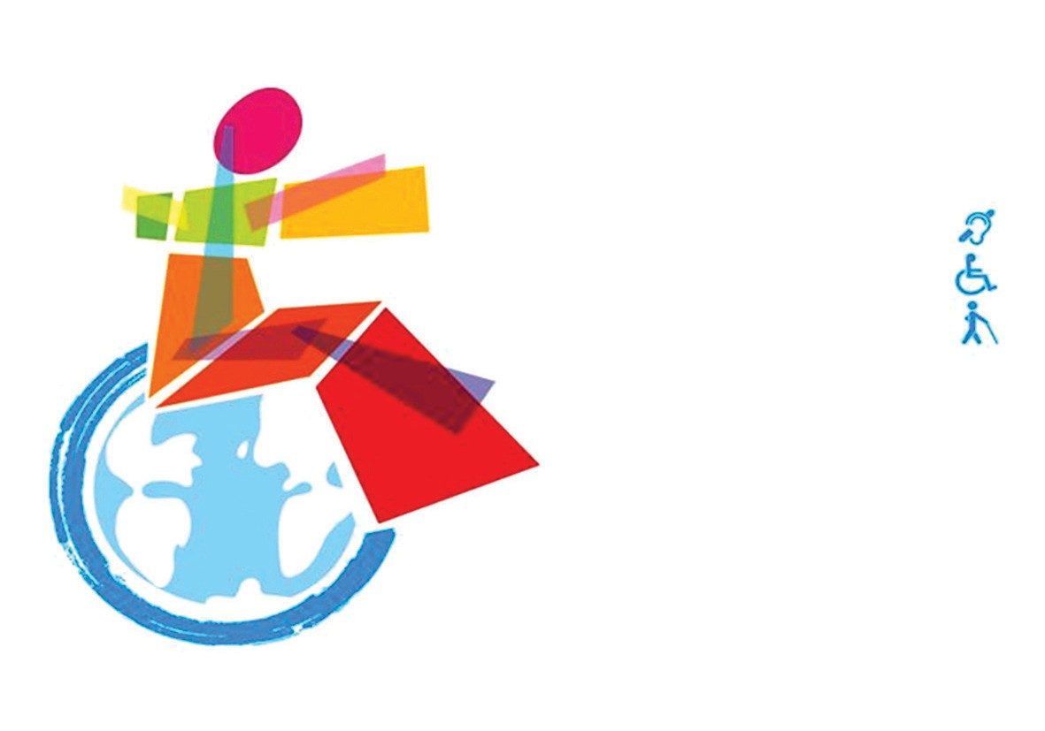
TOURISM
AVAILABLE TO PWDs

Slide 2

Equality among people, whether disabled or not, is a value guaranteed by the UN Convention on the Rights of Persons with Disabilities.
Convention Article 30: guarantees that people with disabilities have access to the services of those involved in the organization of sports, recreational and tourist activities.

Slide 3
According to statistics by Ivor Ambrose, the general director of the European association "Tourism for All", in which travel of people with disabilities makes up one third of European tourism, and annually generate an income of 80 billion euros.
After many years of crisis, Serbia is again in the cycle of acquiring knowledge and some standards that are needed by foreign and domestic tourists with disabilities to use the tourist capacities of our country.

Slide 4
Accessible tourism! What is that?
Accessible tourism is a process that enables people with disabilities and elderly people to function independently and dignity using unified tourism products and services in the environment.
Accessibility not only means adjustment for wheelchair users, this is before all a stance towards barriers.

Slide 5
Types of tourist offers for PWDs:
INDIVIDUAL – GROUP
SPORTS – RECREATIONAL
SPA, ETHNO, CAMPS

Slide 6
TYPES OF HANDICAPS:
*SENSORY
*BODY
* WITH INTELLECTUAL DISABILITIES

Slide 7
The use of language and terminology of disability often indicates the approach people have towards people with disabilities as an approach to the problem of society or as an individual problem.
In everyday speech we encounter a large number of inadequate expressions concerning persons with disabilities. Most of these expressions have even an offensive connotation. The terms used are absolutely unacceptable, especially unacceptable terms of “A PERSON WITH SPECIAL NEEDS” or the term MIDP (mentally insufficiently developed person) when we talk about people with intellectual disabilities.
Generally accepted term - PERSONS WITH DISABILITIES.

Slide 8
Information:
-on the site is different situation from the reality:
The site often shows the availability of hotels for people with disabilities without the detailed description and uncertainty of what is actually available, so often it is a mistake because many hotels mean access to the ramp which allows entrance into the building and forget about the most important: accessible room, toilet, restaurant, swimming pool and all other content available to everyone

Slide 9

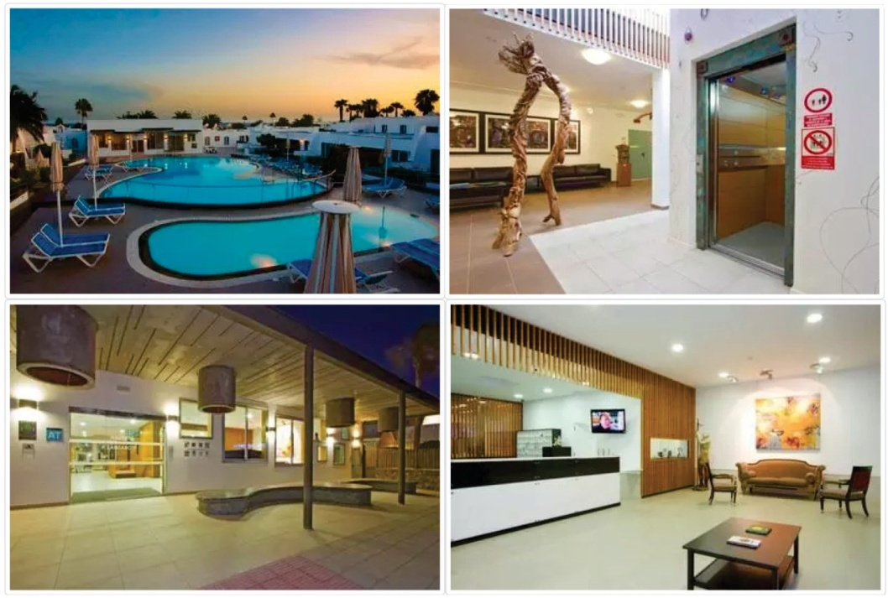
Display of a site that meets the criteria and provides comprehensive information about what it can offer:

Slide 10



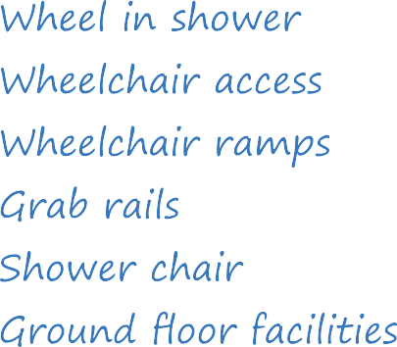








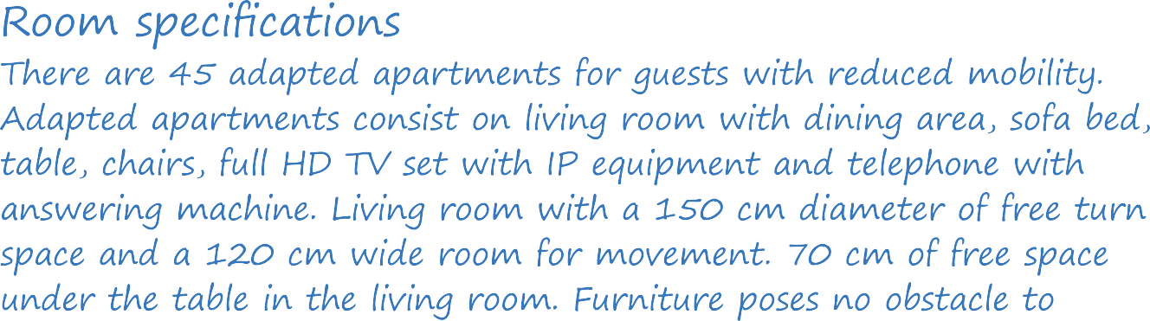

Slide 11
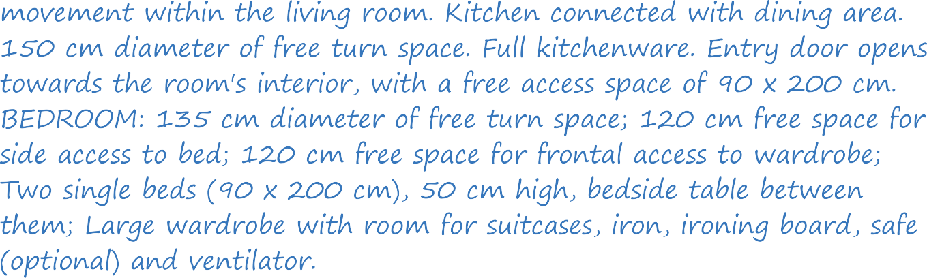
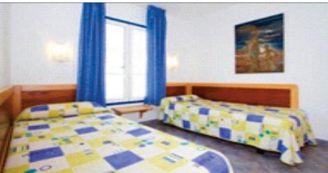
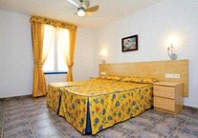
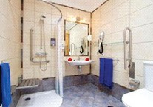

Slide 12
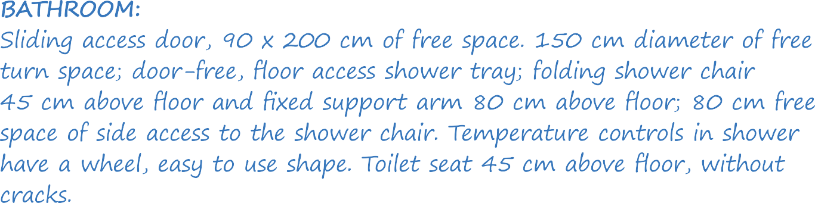
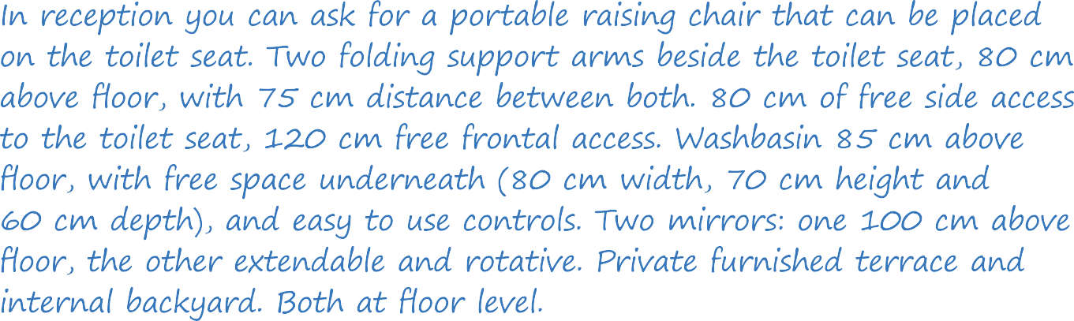

Slide 13
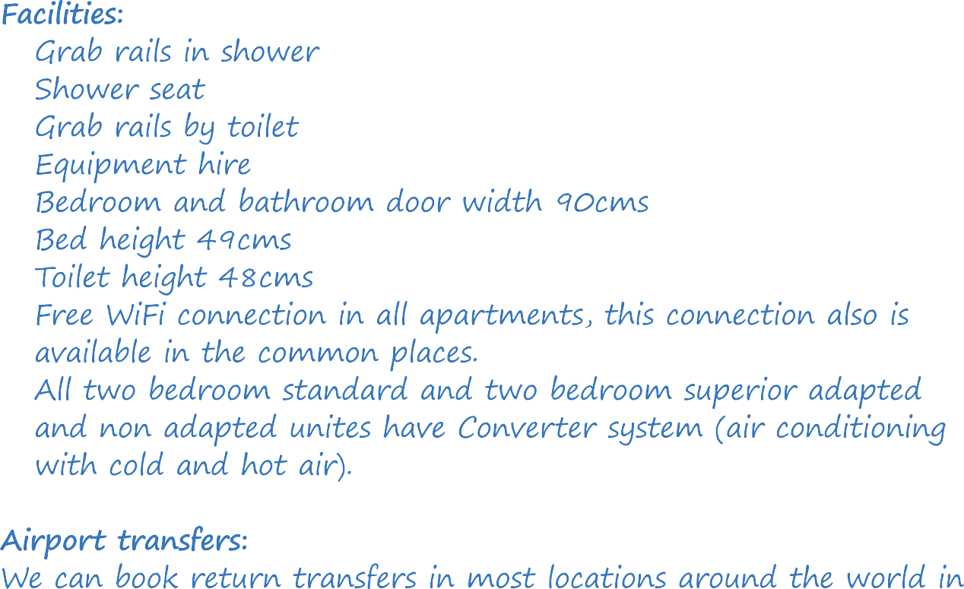

Slide 14

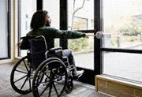
UNIVERSAL DESIGN
Universal design respects human diversity and promotes the inclusion of all people in all life activities. Also, cause there is a little possibility that a product or environment can be used by anyone under all conditions, universal design can be considered before as the process rather than as the achievement.
Reach of people sitting on wheelchairs
The movement of people in wheelchairs due to the seat position is significantly more difficult, so the reach that they can achieve is significantly reduced. Here one has to distinguish those who have upper extremities healthy than those in whom these parts of the body are ill.
In people with ill upper extremities the reach is already reduced due to the illness itself, which is further enhanced by sitting in wheelchairs. It is difficult and uncertain to talk about their reach, because it determines the type and degree of each disease in particular.

Slide 15
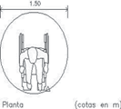
Reaching with your hand in front of you is desirable to be at a height of 110 cm. Reaching a hand in height is desirable to be at a height of 160 cm.
Space required for performing various types of turns for a standard wheelchair
Wheelchairs can be rotated by 90, 180 and 360 degrees. Users of wheelchairs usually use turns of 90 and 180 degrees. 360 degree rotation is performed very rarely and is not common, but it is possible and needs to be analyzed.
All listed rotations, depending on which category of immobile people is in question, can be worked in two ways.
First way : Serving in turning wheelchairs with both hands and turning the drive wheels in the opposite directions – used by people who have both hands healthy. The turning in this way requires less space and is easier to perform.
For single-handed rotation of 180 degrees standard wheelchairs it takes 161cm x 180 cm, and for a turn of 360 degrees, minimum 190 cm x 190 cm. It is desirable to increase the minimum dimensions by 5 – 8 cm.

Slide 16
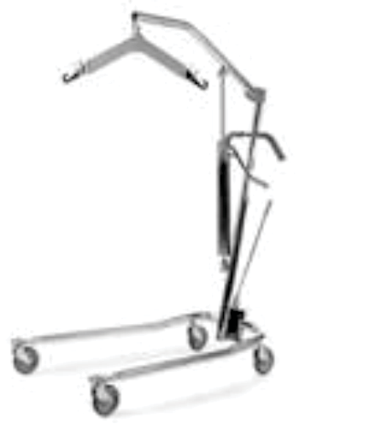
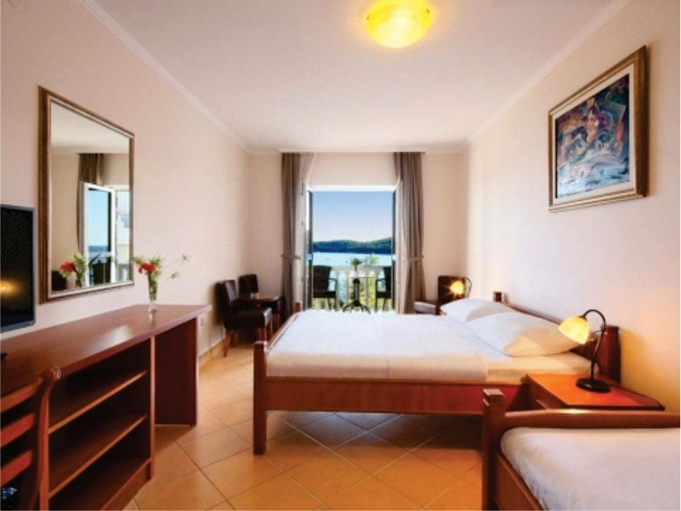
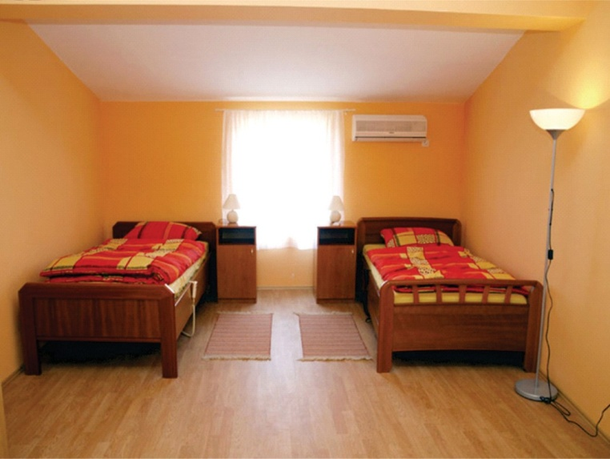
Positive example
The crane can pull in under the bed, because there is enough space for crane and space for wheelchair (the bed is at a sufficient height in relation to the floor)

Slide 17
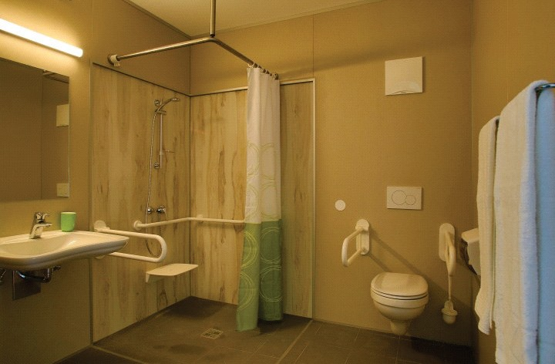
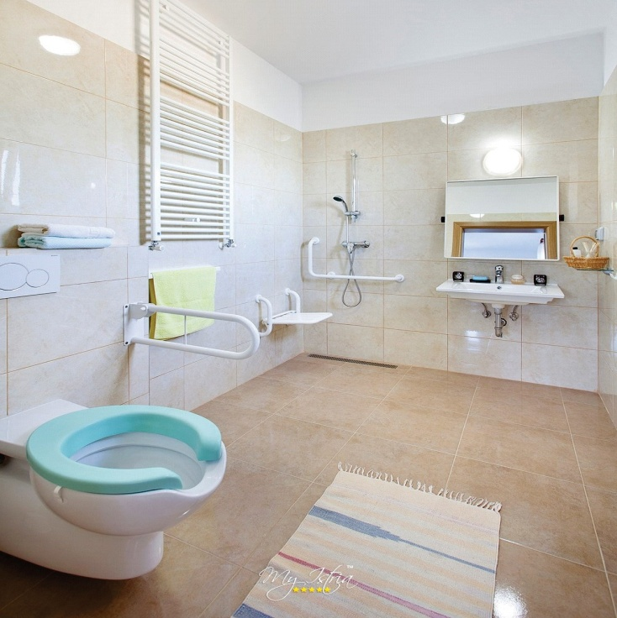
POSITIVE EXAMPLE
Adapted toilets in hotels
(there is enough space for crane and for wheelchair)

Slide 18
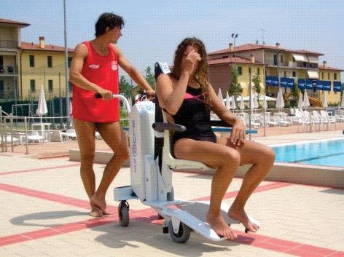
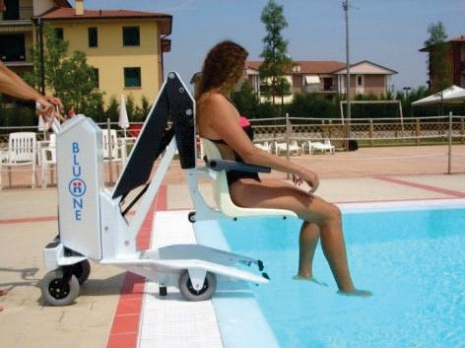
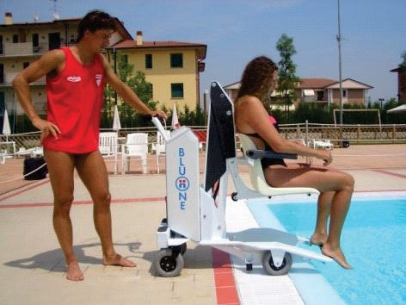
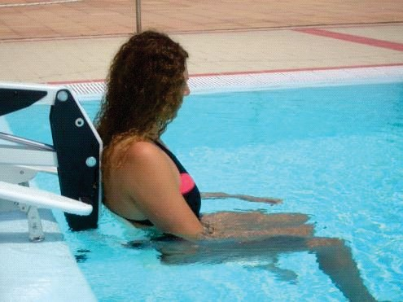
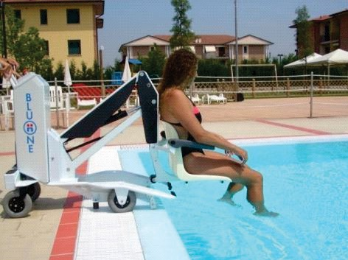
Enabled access to the pool or river

Slide 19
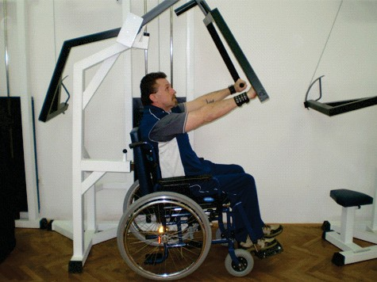
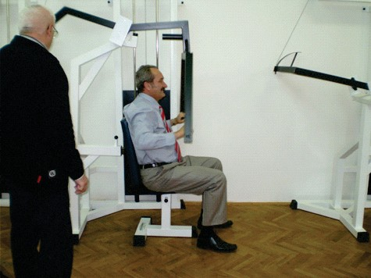
The gym for people with disability

Slide 20
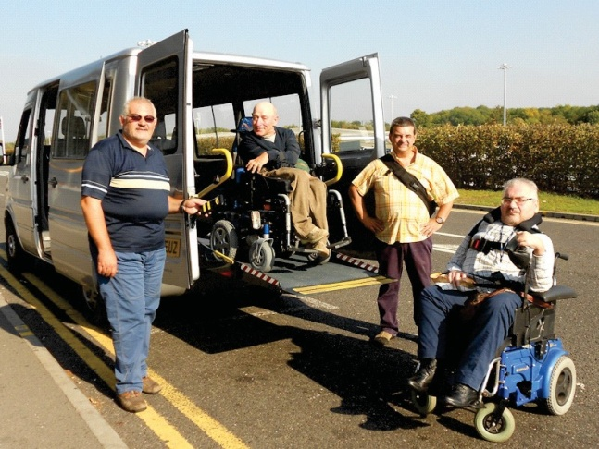
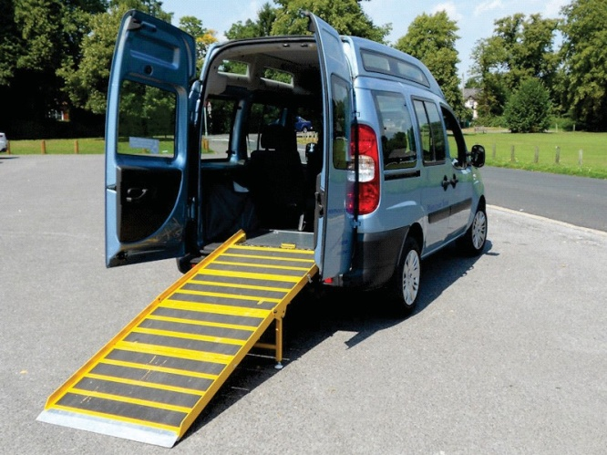
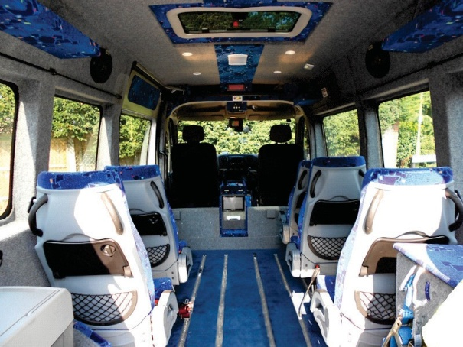
Adapted organized transport for PWDs

Slide 21
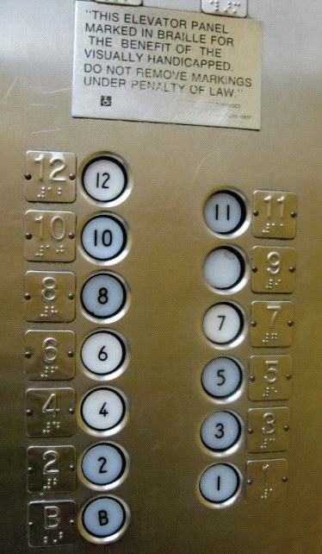
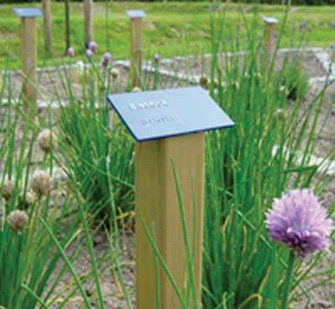

Examples of using characters

Slide 22
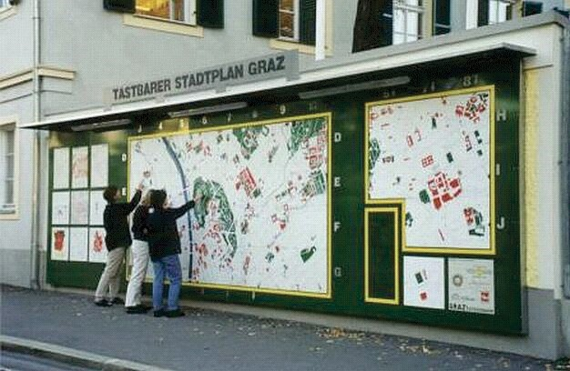
Tactile information plan of tourist destination and local offer

Slide 23
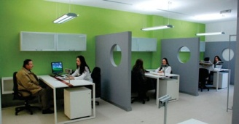
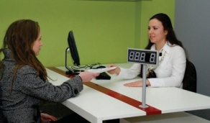
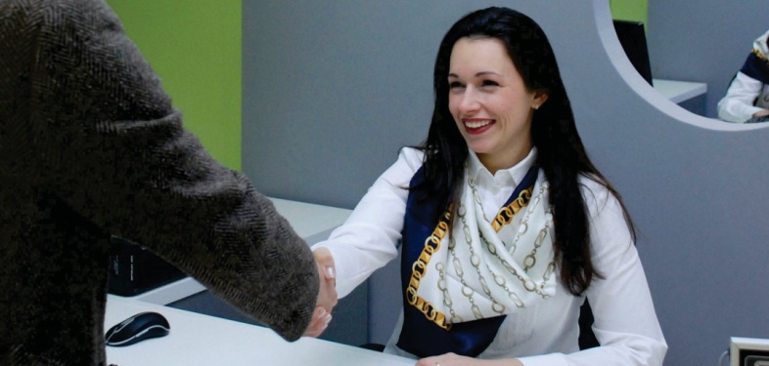
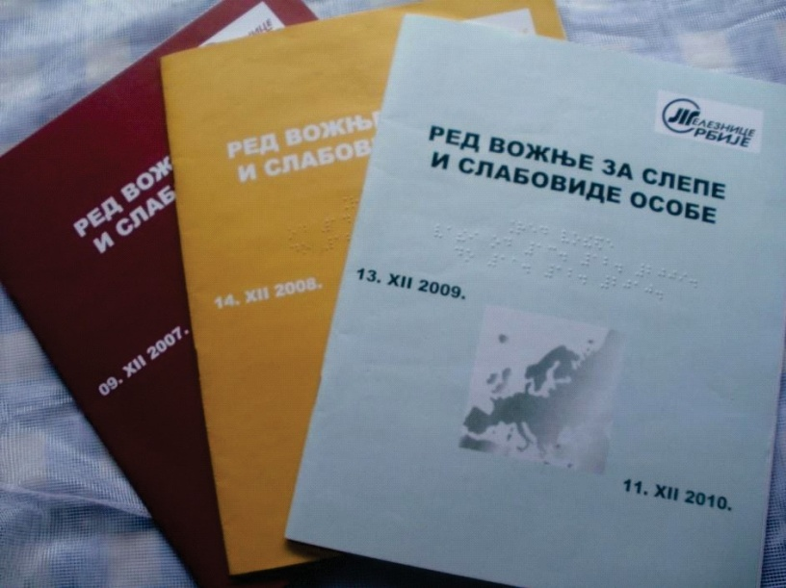
Informers

Slide 24
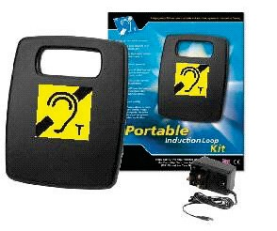
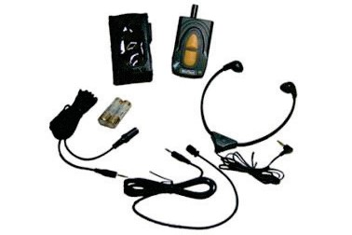

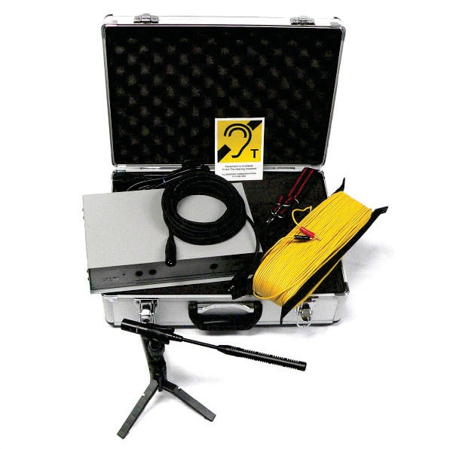
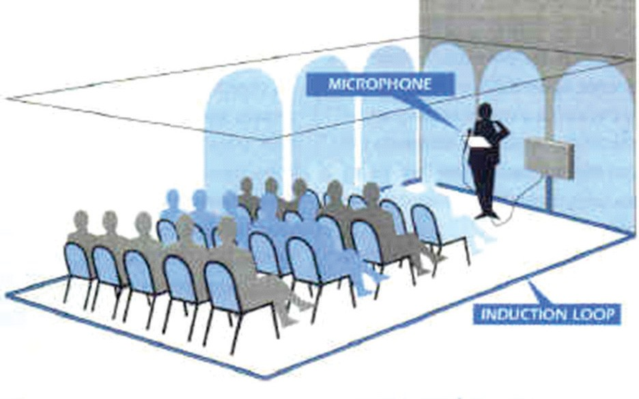
Induction loops used with hearing aids and cochlear implants

Slide 25
People with disabilities represent 50 million people in the European Union (10 since European populations (equivalent to the population of Belgium, the Czech Republic, Greece, Hungary and the Netherlands together.
Investing in this kind of tourism returns investment.
There is no doubt that there is huge space for improvement of the tourist offer for this particular and important market segment.

Slide 26
